Slide 1
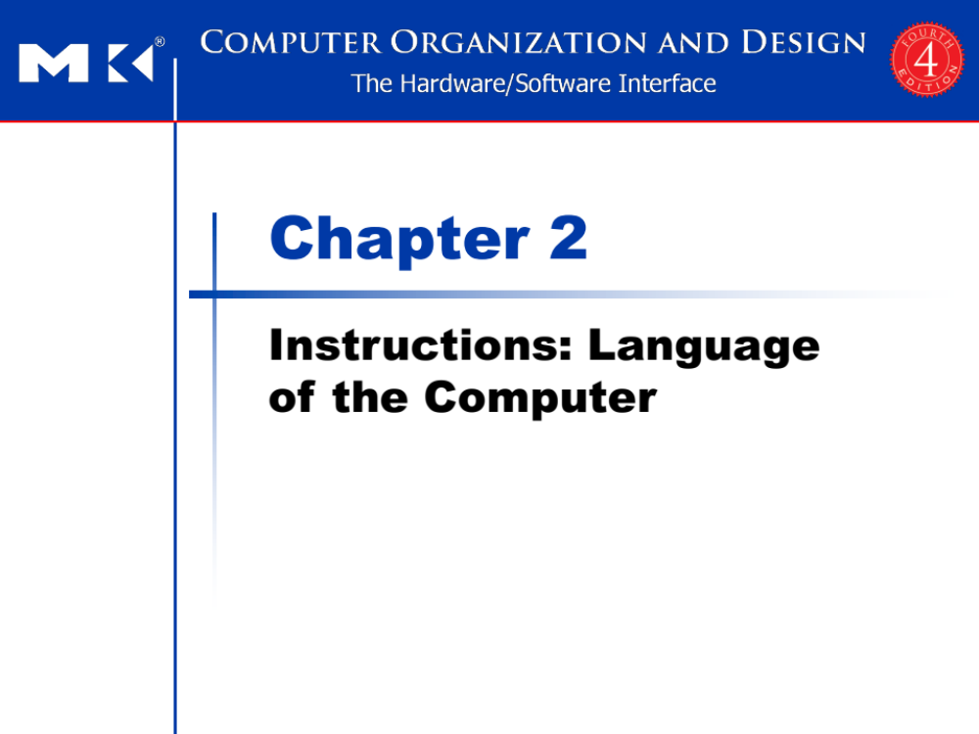
Chapter 2
Instructions: Language of the Computer
Notes:
The University of Adelaide, School of Computer Science
Chapter 2 — Instructions: Language of the Computer

Slide 2
Instruction Set
§2.1 Introduction
The repertoire of instructions of a computer
Different computers have different instruction sets
  But with many aspects in common
Early computers had very simple instruction sets
  Simplified implementation
Many modern computers also have simple instruction sets
Chapter 2 — Instructions: Language of the Computer — <number>
Notes:
The University of Adelaide, School of Computer Science
Chapter 2 — Instructions: Language of the Computer
- To command a computer’s hardware, you must speak its language. The words of a computer’s language are called instructions, and its vocabulary is called an instruction set.
- You might think that the languages of computers would be as diverse as those of people, but in reality computer languages are quite similar, more like regional dialects than like independent languages.

Slide 3
The MIPS Instruction Set
Used as the example throughout the course
Stanford MIPS commercialized by MIPS Technologies (www.mips.com)
Large share of embedded core market
  Applications in consumer electronics, network/storage equipment, cameras, printers, …
Typical of many modern ISAs
  See MIPS Reference Data tear-out card, and Appendixes B and E of the textbook
Chapter 2 — Instructions: Language of the Computer — <number>
Notes:
The University of Adelaide, School of Computer Science
Chapter 2 — Instructions: Language of the Computer
three other popular instruction sets.
- ARMv7 is similar to MIPS. More than 9 billion chips with ARM processors were manufactured in 2011, making it the most popular instruction set in the world.
- The second example is the Intel x86, which powers both the PC and the cloud of the PostPC Era.
- The third example is ARMv8, which extends the address size of the ARMv7 from 32 bits to 64 bits. Ironically, as we shall see, this 2013 instruction set is closer to MIPS than it is to ARMv7.

Slide 4
Arithmetic Operations
Add and subtract, three operands
  Two sources and one destination
add a, b, c # a gets b + c
All arithmetic operations have this form
Design Principle 1: Simplicity favours regularity
  Regularity makes implementation simpler
  Simplicity enables higher performance at lower cost
§2.2 Operations of the Computer Hardware
Chapter 2 — Instructions: Language of the Computer — <number>
Notes:
The University of Adelaide, School of Computer Science
Chapter 2 — Instructions: Language of the Computer
MIPS rule: All arthematic operations (add, subtract) have three operands – no more or no less
In the addition example, three operands are a (source 1), b (source 2), and c (dest), sum of b & c is stored in ‘a’
Why not use variable number of operands?
Design principle: Simplicity favors regularity
Reason: conforms to the philosophy of keeping the hardware simple, hardware for a variable number of operands is more complicated than hardware for a fixed number.

Slide 5
Arithmetic Example
C code:
f = (g + h) - (i + j);
Compiled MIPS code:
add t0, g, h # temp t0 = g + h
add t1, i, j # temp t1 = i + j
sub f, t0, t1 # f = t0 - t1
Chapter 2 — Instructions: Language of the Computer — <number>
Notes:
The University of Adelaide, School of Computer Science
Chapter 2 — Instructions: Language of the Computer
- The translation from C to MIPS assembly language instructions is performed by the compiler.
The compiler must break this statement into several assembly instructions, since only one operation is performed per MIPS instruction.
The first MIPS instruction calculates the sum of g and h. We must place the result somewhere, so the compiler creates a temporary variable, called t0:
add t0,g,h # temporary variable t0 contains g + h
Although the next operation is subtract, we need to calculate the sum of i and j before we can subtract.
Thus, the second instruction places the sum of i and j in another temporary variable created by the compiler, called t1:
add t1,i,j # temporary variable t1 contains i + j
- Finally, the subtract instruction subtracts the second sum from the first and places the difference in the variable f, completing the compiled code:
sub f,t0,t1 # f gets t0 – t1, which is (g + h) – (i + j)

Slide 6
Register Operands
Arithmetic instructions use register
operands
MIPS has a 32 × 32-bit register file
  Use for frequently accessed data
  Numbered 0 to 31
  32-bit data called a “word”
Assembler names
  $t0, $t1, …, $t9 for temporary values
  $s0, $s1, …, $s7 for saved variables
Design Principle 2: Smaller is faster
  c.f. main memory: millions of locations
§2.3 Operands of the Computer Hardware
Chapter 2 — Instructions: Language of the Computer — <number>
Notes:
The University of Adelaide, School of Computer Science
Chapter 2 — Instructions: Language of the Computer
- Operands of arth instruction are restricted; they must be in from a limited number of locations in hardware called registers
Registers are primitives used in hardware design, also visible to programmer when the computer is completed
MIPS-32 architecture has 32 registers each of size 32-bit
t0 – t9, s0 – s7 are registers
t0 – t9 registers used to store temporary values
s0-s7 registers are for saving variables
Design principle: smaller is faster – MIPS architecture has only 32 registers
A very large number of registers may increase the clock cycle time simply because it takes electronic signals longer when they must travel farther.
But main memory has millions of locations
Tradeoff #registers vs clock cycle time

Slide 7
Register Operand Example
C code:
f = (g + h) - (i + j);
  f, …, j in $s0, …, $s4
Compiled MIPS code:
add $t0, $s1, $s2
add $t1, $s3, $s4
sub $s0, $t0, $t1
Chapter 2 — Instructions: Language of the Computer — <number>
Notes:
The University of Adelaide, School of Computer Science
Chapter 2 — Instructions: Language of the Computer
- It is the compiler’s job to associate program variables with registers.
- The variables f, g, h, i, and j are assigned to the registers $s0, $s1, $s2, $s3, and $s4, respectively.
- What is the compiled MIPS code?
- Same as previous, replace the variables with the register names mentioned above plus two temporary registers, $t0 and $t1

Slide 8
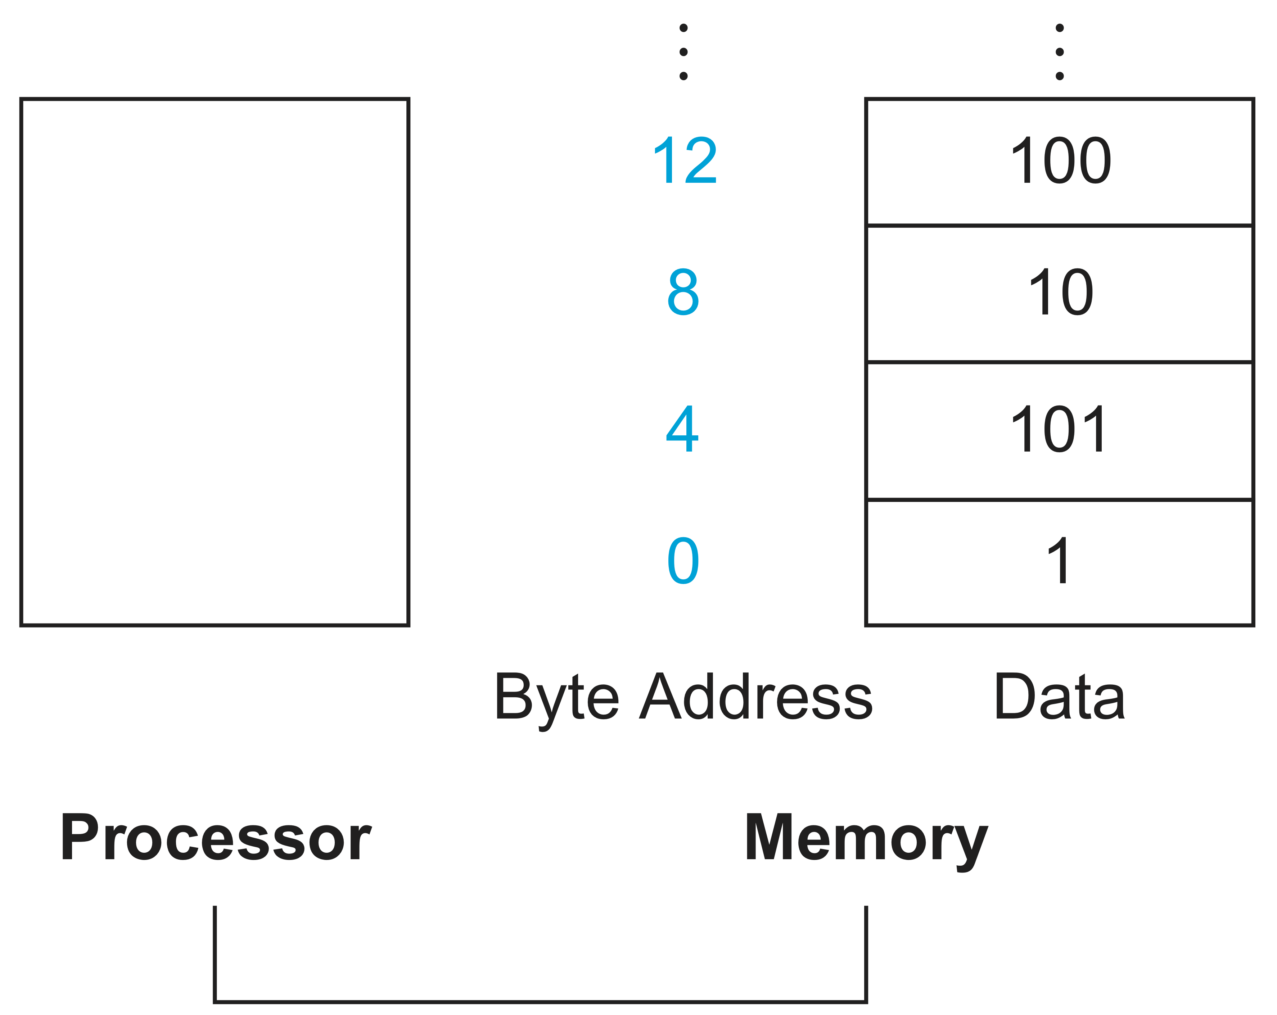
Memory Operands
Main memory used for composite data
  Arrays, structures, dynamic data
To apply arithmetic operations
  Load values from memory into registers
  Store result from register to memory
Memory is byte addressed
  Each address identifies an 8-bit byte
Words are aligned in memory
  Address must be a multiple of 4
MIPS is Big Endian
  Most-significant byte at least address of a word
  c.f. Little Endian: least-significant byte at least address
Chapter 2 — Instructions: Language of the Computer — <number>
Notes:
The University of Adelaide, School of Computer Science
Chapter 2 — Instructions: Language of the Computer
- - It is the compiler’s job to allocate data structures to locations in memory.

Slide 9
Memory Operand Example 1
C code:
g = h + A[8];
  g in $s1, h in $s2, base address of A in $s3
Compiled MIPS code:
  Index 8 requires offset of 32
    4 bytes per word
lw $t0, 32($s3) # load word
add $s1, $s2, $t0
offset
base register
Chapter 2 — Instructions: Language of the Computer — <number>
Notes:
The University of Adelaide, School of Computer Science
Chapter 2 — Instructions: Language of the Computer

Slide 10
Memory Operand Example 2
C code:
A[12] = h + A[8];
  h in $s2, base address of A in $s3
Compiled MIPS code:
  Index 8 requires offset of 32
lw $t0, 32($s3) # load word
add $t0, $s2, $t0
sw $t0, 48($s3) # store word
Chapter 2 — Instructions: Language of the Computer — <number>
Notes:
The University of Adelaide, School of Computer Science
Chapter 2 — Instructions: Language of the Computer

Slide 11
Registers vs. Memory
Registers are faster to access than memory
Operating on memory data requires loads and stores
  More instructions to be executed
Compiler must use registers for variables as much as possible
  Only spill to memory for less frequently used variables
  Register optimization is important!
Chapter 2 — Instructions: Language of the Computer — <number>
Notes:
The University of Adelaide, School of Computer Science
Chapter 2 — Instructions: Language of the Computer
data accesses are faster if data is in registers instead of memory.
Accessing registers also uses less energy than accessing memory.
To achieve highest performance and conserve energy, an instruction set architecture must have a sufficient number of registers, and compilers must use registers efficiently.
A MIPS arithmetic instruction can read two registers, operate on them, and write the result.
A MIPS data transfer instruction only reads one operand or writes one operand, without operating on it.

Slide 12
Immediate Operands
Constant data specified in an instruction
addi $s3, $s3, 4
No subtract immediate instruction
  Just use a negative constant
  addi $s2, $s1, -1
Design Principle 3: Make the common case fast
  Small constants are common
  Immediate operand avoids a load instruction
Chapter 2 — Instructions: Language of the Computer — <number>
Notes:
The University of Adelaide, School of Computer Science
Chapter 2 — Instructions: Language of the Computer
- more than half of the MIPS arithmetic instructions have a constant as an operand when running the SPEC CPU2006 benchmarks - Common
- Using only the instructions we have seen so far, we would have to load a constant from memory to use one. (The constants would have been placed in memory when the program was loaded.)
An alternative that avoids the load instruction is to offer versions of the arithmetic instructions in which one operand is a constant. This quick add instruction with one constant operand is called add immediate or addi.
by including constants inside arithmetic instructions, operations are much faster and use less energy than if constants were loaded from memory.

Slide 13
The Constant Zero
MIPS register 0 ($zero) is the constant 0
  Cannot be overwritten
Useful for common operations
  E.g., move between registers
  add $t2, $s1, $zero
Chapter 2 — Instructions: Language of the Computer — <number>
Notes:
The University of Adelaide, School of Computer Science
Chapter 2 — Instructions: Language of the Computer
Given the importance of registers, what is the rate of increase in the number of registers in a chip over time?
Very fast: They increase as fast as Moore’s law, which predicts doubling the number of transistors on a chip every 18 months.
Very slow: Since programs are usually distributed in the language of the computer, there is inertia in instruction set architecture, and so the number of registers increases only as fast as new instruction sets become viable.

Slide 14
Unsigned Binary Integers
Given an n-bit number
§2.4 Signed and Unsigned Numbers
Range: 0 to +2^{n} – 1
Example
  0000 0000 0000 0000 0000 0000 0000 1011₂
  = 0 + … + 1×2³ + 0×2² +1×2¹ +1×2⁰
  = 0 + … + 8 + 0 + 2 + 1 = 11₁₀
Using 32 bits
  0 to +4,294,967,295
Chapter 2 — Instructions: Language of the Computer — <number>
Notes:
The University of Adelaide, School of Computer Science
Chapter 2 — Instructions: Language of the Computer
Just as base 10 numbers are called decimal numbers, base 2 numbers are called binary numbers
Numbers are kept in computer hardware as a series of high and low electronic signals, and so they are considered base 2 numbers.
Generalizing the point, in any number base, the value of i th digit d is d x Base ^ i - where i starts at 0 and increases from right to left.
Since words are drawn vertically as well as horizontally, leftmost and rightmost may be unclear. Hence, the phrase least significant bit is used to refer to the right- most bit (bit 0 above) and most significant bit to the leftmost bit (bit 31).
The MIPS word is 32 bits long, so we can represent 232 different 32-bit patterns. It is natural to let these combinations represent the numbers from 0 to 232 􏰂1

Slide 15
2s-Complement Signed Integers
Given an n-bit number
Range: –2^{n – 1} to +2^{n – 1} – 1
Example
  1111 1111 1111 1111 1111 1111 1111 1100₂
  = –1×2³¹ + 1×2³⁰ + … + 1×2² +0×2¹ +0×2⁰
  = –2,147,483,648 + 2,147,483,644 = –4₁₀
Using 32 bits
  –2,147,483,648 to +2,147,483,647
Chapter 2 — Instructions: Language of the Computer — <number>
Notes:
The University of Adelaide, School of Computer Science
Chapter 2 — Instructions: Language of the Computer
0000 0000 0000 0000 0000 0000 0000 0000 = 0
0000 0000 0000 0000 0000 0000 0000 0001 = 1ten
0000 0000 0000 0000 0000 0000 0000 0010 = 2ten
...
0111 1111 1111 1111 1111 1111 1111 1101= 2,147,483,645
0111 1111 1111 1111 1111 1111 1111 1110 = 2,147,483,646
0111 1111 1111 1111 1111 1111 1111 1111 = 2,147,483,647
1000 0000 0000 0000 0000 0000 0000 0000 = 2,147,483,648
1000 0000 0000 0000 0000 0000 0000 0001 = 2,147,483,647
1000 0000 0000 0000 0000 0000 0000 0010 = 2,147,483,646
….
1111 1111 1111 1111 1111 1111 1111 1101 = -3
1111 1111 1111 1111 1111 1111 1111 1110 = -2
1111 1111 1111 1111 1111 1111 1111 1111 = -1

Slide 16
2s-Complement Signed Integers
Bit 31 is sign bit
  1 for negative numbers
  0 for non-negative numbers
–(–2^{n – 1}) can’t be represented
Non-negative numbers have the same unsigned and 2s-complement representation
Some specific numbers
  0: 0000 0000 … 0000
  –1: 1111 1111 … 1111
  Most-negative: 1000 0000 … 0000
  Most-positive: 0111 1111 … 1111
Chapter 2 — Instructions: Language of the Computer — <number>
Notes:
The University of Adelaide, School of Computer Science
Chapter 2 — Instructions: Language of the Computer
leading 0s mean positive, and leading 1s mean negative.
This convention for representing signed binary numbers is called two’s complement representation

Slide 17

Signed Negation
Complement and add 1
  Complement means 1 → 0, 0 → 1
Example: negate +2
  +2 = 0000 0000 … 0010₂
  –2 = 1111 1111 … 1101₂ + 1
  = 1111 1111 … 1110₂
Chapter 2 — Instructions: Language of the Computer — <number>
Notes:
The University of Adelaide, School of Computer Science
Chapter 2 — Instructions: Language of the Computer
we need to represent both positive and negative integers within a computer word

Slide 18
Representing Instructions
Instructions are encoded in binary
  Called machine code
MIPS instructions
  Encoded as 32-bit instruction words
  Small number of formats encoding operation code (opcode), register numbers, …
  Regularity!
Register numbers
  $t0 – $t7 are reg’s 8 – 15
  $t8 – $t9 are reg’s 24 – 25
  $s0 – $s7 are reg’s 16 – 23
§2.5 Representing Instructions in the Computer
Chapter 2 — Instructions: Language of the Computer — <number>
Notes:
The University of Adelaide, School of Computer Science
Chapter 2 — Instructions: Language of the Computer
- We are now ready to explain the difference between the way humans instruct computers and the way computers see instructions.
Instructions are kept in the computer as a series of high and low electronic signals and may be represented as numbers. In fact, each piece of an instruction can be considered as an individual number, and placing these numbers side by side forms the instruction.
Since registers are referred to in instructions, there must be a convention to map register names into numbers. In MIPS assembly language, registers $s0 to $s7 map onto registers 16 to 23, and registers $t0 to $t7 map onto registers 8 to 15. Hence, $s0 means register 16, $s1 means register 17, $s2 means register 18, . . . , $t0 means register 8, $t1 means register 9, and so on.

Slide 19
MIPS R-format Instructions
op
rs
rt
rd
shamt
funct
6 bits
5 bits
5 bits
5 bits
5 bits
6 bits
Instruction fields
  op: operation code (opcode)
  rs: first source register number
  rt: second source register number
  rd: destination register number
  shamt: shift amount (00000 for now)
  funct: function code (extends opcode)
Chapter 2 — Instructions: Language of the Computer — <number>
Notes:
The University of Adelaide, School of Computer Science
Chapter 2 — Instructions: Language of the Computer
This layout of the instruction is called the instruction format. As you can see from counting the number of bits, this MIPS instruction takes exactly 32 bits—the same size as a data word. In keeping with our design principle that simplicity favors regularity, all MIPS instructions are 32 bits long
Here is the meaning of each name of the fields in MIPS instructions:
■ op: Basic operation of the instruction, traditionally called the opcode.
■ rs: The first register source operand.
■ rt: The second register source operand.
■ rd: The register destination operand. It gets the result of the operation.
■ shamt: Shift amount. (I will explaing why the field contains zero later.)
■ funct: Function. This field, often called the function code, selects the specific variant of the operation in the op field.

Slide 20
R-format Example
op
rs
rt
rd
shamt
funct
6 bits
5 bits
5 bits
5 bits
5 bits
6 bits
add $t0, $s1, $s2
special
$s1
$s2
$t0
0
add
0
17
18
8
0
32
000000
10001
10010
01000
00000
100000
00000010001100100100000000100000₂ = 02324020₁₆
Chapter 2 — Instructions: Language of the Computer — <number>
Notes:
The University of Adelaide, School of Computer Science
Chapter 2 — Instructions: Language of the Computer
We’ll show the real MIPS language version of the instruction represented symbolically as
add $t0,$s1,$s2 → assembly language
first as a combination of decimal numbers and then of binary numbers.
The decimal representation is
Each of these segments of an instruction is called a field. The first and last fields (containing 0 and 32 in this case) in combination tell the MIPS computer that this instruction performs addition. The second field gives the number of the register that is the first source operand of the addition operation (17 = $s1), and the third field gives the other source operand for the addition (18 􏰁 $s2). The fourth field contains the number of the register that is to receive the sum (8 = $t0). The fifth field is unused in this instruction, so it is set to 0. Thus, this instruction adds register $s1 to register $s2 and places the sum in register $t0.
This instruction can also be represented as fields of binary numbers as opposed to decimal, as shown above.
To distinguish it from assembly language, we call the numeric version of instructions machine language and a sequence of such instructions machine code.

Slide 21
Hexadecimal
Base 16
  Compact representation of bit strings
  4 bits per hex digit
0 | 0000 | 4 | 0100 | 8 | 1000 | c | 1100
1 | 0001 | 5 | 0101 | 9 | 1001 | d | 1101
2 | 0010 | 6 | 0110 | a | 1010 | e | 1110
3 | 0011 | 7 | 0111 | b | 1011 | f | 1111
Example: eca8 6420
  1110 1100 1010 1000 0110 0100 0010 0000
Chapter 2 — Instructions: Language of the Computer — <number>
Notes:
The University of Adelaide, School of Computer Science
Chapter 2 — Instructions: Language of the Computer
It would appear that you would now be reading and writing long, tedious strings of binary numbers. We avoid that tedium by using a higher base than binary that converts easily into binary. Since almost all computer data sizes are multiples of 4, hexadecimal (base 16) numbers are popular. Since base 16 is a power of 2, we can trivially convert by replacing each group of four binary digits by a single hexadecimal digit, and vice versa.
the table converts between hexadecimal and binary.

Slide 22
MIPS I-format Instructions
op
rs
rt
constant or address
6 bits
5 bits
5 bits
16 bits
Immediate arithmetic and load/store instructions
  rt: destination or source register number
  Constant: –2¹⁵ to +2¹⁵ – 1
  Address: offset added to base address in rs
Design Principle 4: Good design demands good compromises
  Different formats complicate decoding, but allow 32-bit instructions uniformly
  Keep formats as similar as possible
Chapter 2 — Instructions: Language of the Computer — <number>
Notes:
The University of Adelaide, School of Computer Science
Chapter 2 — Instructions: Language of the Computer
The compromise chosen by the MIPS designers is to keep all instructions the same length, thereby requiring different kinds of instruction formats for different kinds of instructions. For example, the format we looked at so far is called R-type (for register) or R-format.
A second type of instruction format shown here is called I-type (for immediate) or I-format and is used by the immediate and data transfer instructions. The fields of I-format are op (6bits), rs (5bits), rt(5bits), constant or address (16bits)
g = h + A[8]; →. lw $t0,32($s3) # Temporary reg $t0 gets A[8]
The 16-bit address means a load word instruction can load any word within a region of + or – 2^15 or 32,768 bytes (+or- 2^13 or 8192 words) of the address in the base register rs
Here, 19 (for $s3) is placed in the rs field, 8 (for $t0) is placed in the rt field, and 32 is placed in the address field. Note that the meaning of the rt field has changed for this instruction: in a load word instruction, the rt field specifies the destination register, which receives the result of the load.
Although multiple formats complicate the hardware, we can reduce the complexity by keeping the formats similar. For example, the first three fields of the R-type and I-type formats are the same size and have the same names; the length of the fourth field in I-type is equal to the sum of the lengths of the last three fields of R-type.

Slide 23
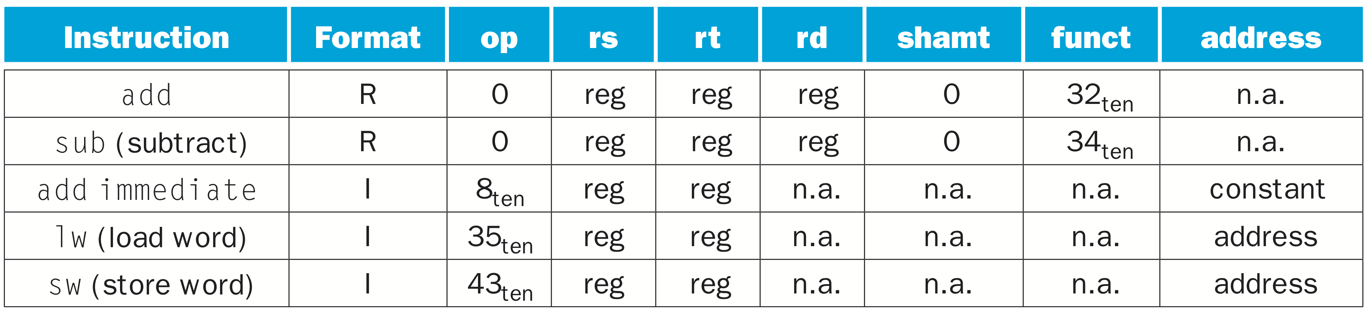
MIPS Instruction encoding
Chapter 2 — Instructions: Language of the Computer — <number>
Notes:
In the table above, “reg” means a register number between 0 and 31, “address” means a 16-bit address, and “n.a.” (not applicable) means this field does not appear in this format. Note that add and sub instructions have the same value in the op field; the hardware uses the funct field to decide the variant of the operation: add (32) or subtract (34).
The desire to keep all instructions the same size is in conflict with the desire to have as many registers as possible. Any increase in the number of registers uses up at least one more bit in every register field of the instruction format. Given these constraints and the design princple that smaller is faster, most instruction sets today have 16 or 32 general purpose registers.
The University of Adelaide, School of Computer Science
Chapter 2 — Instructions: Language of the Computer

Slide 24
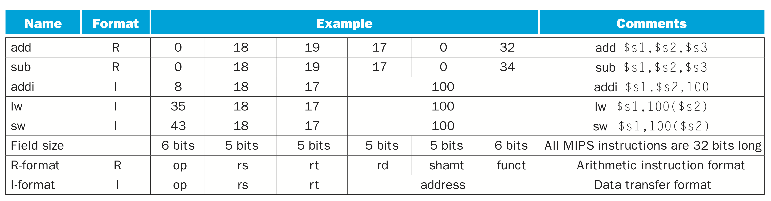
MIPS machine language
Chapter 2 — Instructions: Language of the Computer — <number>
Notes:
The two MIPS instruction formats so far are R and I. The first 16 bits are the same: both contain an op field, giving the base operation; an rs field, giving one of the sources; and the rt field, which specifies the other source operand, except for load word, where it specifies the destination register. R-format divides the last 16 bits into an rd field, specifying the destination register; the shamt field, which we explain it later; and the funct field, which specifies the specific operation of R-format instructions. I-format combines the last 16 bits into a single address field.
Today’s computers are built on two key principles:
Instructions are represented as numbers.
Programs are stored in memory to be read or written, just like data.
The University of Adelaide, School of Computer Science
Chapter 2 — Instructions: Language of the Computer

Slide 25

Stored Program Computers
The BIG Picture
Instructions represented in binary, just like data
Instructions and data stored in memory
Programs can operate on programs
  e.g., compilers, linkers, …
Binary compatibility allows compiled programs to work on different computers
  Standardized ISAs
Chapter 2 — Instructions: Language of the Computer — <number>
Notes:
The University of Adelaide, School of Computer Science
Chapter 2 — Instructions: Language of the Computer
The stored-program concept. Stored programs allow a computer that performs accounting to become, in the blink of an eye, a computer that helps an author write a book. The switch happens simply by loading memory with programs and data and then telling the computer to begin executing at a given location in memory. Treating instructions in the same way as data greatly simplifies both the memory hardware and the software of computer systems. Specifically, the memory technology needed for data can also be used for programs, and programs like compilers, for instance, can translate code written in a notation far more convenient for humans into code that the computer can understand.
shows the power of the concept; Imagine you are writing a ‘c’ program using an editor (gedit, vim). Here memory can contain the source code for an editor program, the corresponding compiled machine code of editor program, the text that the compiled program is using, and even the compiler that generated the machine code from ‘C’ program.
One consequence of instructions as numbers is that programs are often shipped as files of binary numbers. The commercial implication is that computers can inherit ready-made software provided they are compatible with an existing instruction set. Such “binary compatibility” often leads industry to align around a small number of instruction set architectures.

Slide 26
Logical Operations
Instructions for bitwise manipulation
§2.6 Logical Operations
Operation | C | Java | MIPS
Shift left | << | << | sll
Shift right | >> | >>> | srl
Bitwise AND | & | & | and, andi
Bitwise OR | | | | | or, ori
Bitwise NOT | ~ | ~ | nor
Useful for extracting and inserting groups of bits in a word
Chapter 2 — Instructions: Language of the Computer — <number>
Notes:
The University of Adelaide, School of Computer Science
Chapter 2 — Instructions: Language of the Computer

Slide 27
Shift Operations
op
rs
rt
rd
shamt
funct
6 bits
5 bits
5 bits
5 bits
5 bits
6 bits
shamt: how many positions to shift
Shift left logical
  Shift left and fill with 0 bits
  sll by i bits multiplies by 2^{i}
Shift right logical
  Shift right and fill with 0 bits
  srl by i bits divides by 2^{i} (unsigned only)
Chapter 2 — Instructions: Language of the Computer — <number>
Notes:
The University of Adelaide, School of Computer Science
Chapter 2 — Instructions: Language of the Computer

Slide 28
AND Operations
Useful to mask bits in a word
  Select some bits, clear others to 0
and $t0, $t1, $t2
$t2
0000 0000 0000 0000 0000 1101 1100 0000
$t1
0000 0000 0000 0000 0011 1100 0000 0000
$t0
0000 0000 0000 0000 0000 1100 0000 0000
Chapter 2 — Instructions: Language of the Computer — <number>
Notes:
The University of Adelaide, School of Computer Science
Chapter 2 — Instructions: Language of the Computer

Slide 29
OR Operations
Useful to include bits in a word
  Set some bits to 1, leave others unchanged
or $t0, $t1, $t2
$t2
0000 0000 0000 0000 0000 1101 1100 0000
$t1
0000 0000 0000 0000 0011 1100 0000 0000
$t0
0000 0000 0000 0000 0011 1101 1100 0000
Chapter 2 — Instructions: Language of the Computer — <number>
Notes:
The University of Adelaide, School of Computer Science
Chapter 2 — Instructions: Language of the Computer

Slide 30
NOT Operations
Useful to invert bits in a word
  Change 0 to 1, and 1 to 0
MIPS has NOR 3-operand instruction
  a NOR b == NOT ( a OR b )
nor $t0, $t1, $zero
Register 0: always read as zero
$t1
0000 0000 0000 0000 0011 1100 0000 0000
$t0
1111 1111 1111 1111 1100 0011 1111 1111
Chapter 2 — Instructions: Language of the Computer — <number>
Notes:
The University of Adelaide, School of Computer Science
Chapter 2 — Instructions: Language of the Computer

Slide 31
Conditional Operations
Branch to a labeled instruction if a condition is true
  Otherwise, continue sequentially
beq rs, rt, L1
  if (rs == rt) branch to instruction labeled L1;
bne rs, rt, L1
  if (rs != rt) branch to instruction labeled L1;
j L1
  unconditional jump to instruction labeled L1
§2.7 Instructions for Making Decisions
Chapter 2 — Instructions: Language of the Computer — <number>
Notes:
The University of Adelaide, School of Computer Science
Chapter 2 — Instructions: Language of the Computer

Slide 32

Compiling If Statements
C code:
if (i==j) f = g+h;
else f = g-h;
  f, g, … in $s0, $s1, …
Compiled MIPS code:
bne $s3, $s4, Else
add $s0, $s1, $s2
j Exit
Else: sub $s0, $s1, $s2
Exit: …
Assembler calculates addresses
Chapter 2 — Instructions: Language of the Computer — <number>
Notes:
The University of Adelaide, School of Computer Science
Chapter 2 — Instructions: Language of the Computer

Slide 33
Compiling Loop Statements
C code:
while (save[i] == k) i += 1;
  i in $s3, k in $s5, address of save in $s6
Compiled MIPS code:
Loop: sll $t1, $s3, 2
add $t1, $t1, $s6
lw $t0, 0($t1)
bne $t0, $s5, Exit
addi $s3, $s3, 1
j Loop
Exit: …
Chapter 2 — Instructions: Language of the Computer — <number>
Notes:
The University of Adelaide, School of Computer Science
Chapter 2 — Instructions: Language of the Computer

Slide 34
Basic Blocks
A basic block is a sequence of instructions with
  No embedded branches (except at end)
  No branch targets (except at beginning)
A compiler identifies basic blocks for optimization
An advanced processor can accelerate execution of basic blocks
Chapter 2 — Instructions: Language of the Computer — <number>
Notes:
The University of Adelaide, School of Computer Science
Chapter 2 — Instructions: Language of the Computer

Slide 35
More Conditional Operations
Set result to 1 if a condition is true
  Otherwise, set to 0
slt rd, rs, rt
  if (rs < rt) rd = 1; else rd = 0;
slti rt, rs, constant
  if (rs < constant) rt = 1; else rt = 0;
Use in combination with beq, bne
  slt $t0, $s1, $s2 # if ($s1 < $s2)
  bne $t0, $zero, L # branch to L
Chapter 2 — Instructions: Language of the Computer — <number>
Notes:
The University of Adelaide, School of Computer Science
Chapter 2 — Instructions: Language of the Computer

Slide 36
Branch Instruction Design
Why not blt, bge, etc?
Hardware for <, ≥, … slower than =, ≠
  Combining with branch involves more work per instruction, requiring a slower clock
  All instructions penalized!
beq and bne are the common case
This is a good design compromise
Chapter 2 — Instructions: Language of the Computer — <number>
Notes:
The University of Adelaide, School of Computer Science
Chapter 2 — Instructions: Language of the Computer

Slide 37
Signed vs. Unsigned
Signed comparison: slt, slti
Unsigned comparison: sltu, sltui
Example
  $s0 = 1111 1111 1111 1111 1111 1111 1111 1111
  $s1 = 0000 0000 0000 0000 0000 0000 0000 0001
  slt $t0, $s0, $s1 # signed
    –1 < +1 ⇒ $t0 = 1
  sltu $t0, $s0, $s1 # unsigned
    +4,294,967,295 > +1 ⇒ $t0 = 0
Chapter 2 — Instructions: Language of the Computer — <number>
Notes:
The University of Adelaide, School of Computer Science
Chapter 2 — Instructions: Language of the Computer

Slide 38
Procedure Calling
Steps required
  Place parameters in registers
  Transfer control to procedure
  Acquire storage for procedure
  Perform procedure’s operations
  Place result in register for caller
  Return to place of call
§2.8 Supporting Procedures in Computer Hardware
Chapter 2 — Instructions: Language of the Computer — <number>
Notes:
The University of Adelaide, School of Computer Science
Chapter 2 — Instructions: Language of the Computer
A procedure or function is one tool programmers use to structure programs, both to make them easier to understand and to allow code to be reused. Procedures allow the programmer to concentrate on just one portion of the task at a time; parameters act as an interface between the procedure and the rest of the program and data, since they can pass values and return results.
You can think of a procedure like a spy who leaves with a secret plan, acquires resources, performs the task, covers his or her tracks, and then returns to the point of origin with the desired result.
Similarly, in the execution of a procedure, the program must follow these six steps:
1. Put parameters in a place where the procedure can access them.
2. Transfer control to the procedure.
3. Acquire the storage resources needed for the procedure.
4. Perform the desired task.
5. Put the result value in a place where the calling program can access it.
6. Return control to the point of origin, since a procedure can be called from several points in a program.

Slide 39
Register Usage
$a0 – $a3: arguments (reg’s 4 – 7)
$v0, $v1: result values (reg’s 2 and 3)
$t0 – $t9: temporaries
  Can be overwritten by callee
$s0 – $s7: saved
  Must be saved/restored by callee
$gp: global pointer for static data (reg 28)
$sp: stack pointer (reg 29)
$fp: frame pointer (reg 30)
$ra: return address (reg 31)
Chapter 2 — Instructions: Language of the Computer — <number>
Notes:
The University of Adelaide, School of Computer Science
Chapter 2 — Instructions: Language of the Computer
MIPS software follows the following convention for procedure calling in allocating its 32 registers:
■ $a0–$a3: four argument registers in which to pass parameters
■ $v0–$v1: two value registers in which to return values
■ $ra: one return address register to return to the point of origin

Slide 40
Procedure Call Instructions
Procedure call: jump and link
jal ProcedureLabel
  Address of following instruction put in $ra
  Jumps to target address
Procedure return: jump register
jr $ra
  Copies $ra to program counter
  Can also be used for computed jumps
    e.g., for case/switch statements
Chapter 2 — Instructions: Language of the Computer — <number>
Notes:
The University of Adelaide, School of Computer Science
Chapter 2 — Instructions: Language of the Computer
Imaging a ‘C’ code
f()
{
statement A
statement B
return
}
main()
{
statement w
statement x
f()
statement y
statement z
….
}
Imagine the following instructions in a main function:
inst w
inst x
jump procedurelabel
inst y
inst z
..
..
procedurelabel: inst A
inst B
..
..
..
go back to inst z
How to go back to main and execute remaining instructions in main() function, that is from statement z to the end.
answer is jal ProcedureAddress → MIPS assembly language includes jal instruction just for the procedures: jal jumps to an address and simultaneously saves the address of the following instruction in register $ra.
Here the following instruction has inst y. So $ra is loaded with the address of inst y.
Now, before exit the procedure call unconditional jump to location in $ra using jr $ra instruction.
The jal instruction actually saves PC+4 in register $ra to link to the following instruction to set up the procedure return.
Note, processor has a special register called programcounter, which has address to the instruction that should be executed. So jr $ra copies address of inst y to PC.

Slide 41
Leaf Procedure Example
C code:
int leaf_example (int g, h, i, j)
{ int f;
f = (g + h) - (i + j);
return f;
}
  Arguments g, …, j in $a0, …, $a3
  f in $s0 (hence, need to save $s0 on stack)
  Result in $v0
Chapter 2 — Instructions: Language of the Computer — <number>
Notes:
The University of Adelaide, School of Computer Science
Chapter 2 — Instructions: Language of the Computer
Suppose a compiler needs more registers for a procedure than the four argument and two return value registers. Since we must cover our tracks after our mission is complete, any registers needed by the caller must be restored to the values that they contained before the procedure was invoked. This situation is an example in which we need to spill registers to memory.
The ideal data structure for spilling registers is a stack—a last-in-first-out queue. A stack needs a pointer to the most recently allocated address in the stack to show where the next procedure should place the registers to be spilled or where old register values are found. The stack pointer is adjusted by one word for each register that is saved or restored. MIPS software reserves register 29 for the stack pointer, giving it the obvious name $sp. Stacks are so popular that they have their own buzzwords for transferring data to and from the stack: placing data onto the stack is called a push, and removing data from the stack is called a pop.
By historical precedent, stacks “grow” from higher addresses to lower addresses. This convention means that you push values onto the stack by subtracting from the stack pointer. Adding to the stack pointer shrinks the stack, thereby popping values off the stack.
The parameter variables g, h, i, and j correspond to the argument registers $a0, $a1, $a2, and $a3, and f corresponds to $s0, result of leaf_example in $v0

Slide 42
Leaf Procedure Example
MIPS code:
leaf_example:
addi $sp, $sp, -4
sw $s0, 0($sp)
add $t0, $a0, $a1
add $t1, $a2, $a3
sub $s0, $t0, $t1
add $v0, $s0, $zero
lw $s0, 0($sp)
addi $sp, $sp, 4
jr $ra
Save $s0 on stack
Procedure body
Result
Restore $s0
Return
Chapter 2 — Instructions: Language of the Computer — <number>
Notes:
The University of Adelaide, School of Computer Science
Chapter 2 — Instructions: Language of the Computer
leaf_example:
1. The next step is to save the registers used by the procedure. We save $s0 value onto the stack by creating space for a word (4 bytes) on the stack and then store them.
2. The next three statements correspond to the body of the procedure
3. To return the value of f (s0) we copy it into a return value register $v0
4. Before returning, we restore the old value of s0 register we saved by “popping” it from the stack
5. The procedure ends with a jump register using the return address:

Slide 43
Non-Leaf Procedures
Procedures that call other procedures
For nested call, caller needs to save on the stack:
  Its return address
  Any arguments and temporaries needed after the call
Restore from the stack after the call
Chapter 2 — Instructions: Language of the Computer — <number>
Notes:
The University of Adelaide, School of Computer Science
Chapter 2 — Instructions: Language of the Computer
Procedures that do not call others are called leaf procedures. Life would be simple if all procedures were leaf procedures, but they aren’t. Just as a spy might employ other spies as part of a mission, who in turn might use even more spies, so do procedures invoke other procedures. Moreover, recursive procedures even invoke “clones” of themselves. Just as we need to be careful when using registers in procedures, more care must also be taken when invoking nonleaf procedures.
For example, suppose that the main program calls procedure A with an argument of 3, by placing the value 3 into register $a0 and then using jal A. Then suppose that procedure A calls procedure B via jal B with an argument of 7, also placed in $a0. Since A hasn’t finished its task yet, there is a conflict over the use of register $a0. Similarly, there is a conflict over the return address in register $ra, since it now has the return address for B. Unless we take steps to prevent the problem, this conflict will eliminate procedure A’s ability to return to its caller.
One solution is to push all the other registers that must be preserved onto the stack, just as we did with the saved registers.

Slide 44
Non-Leaf Procedure Example
C code:
int fact (int n)
{
if (n < 1) return 1;
else return n * fact(n - 1);
}
  Argument n in $a0
  Result in $v0
Chapter 2 — Instructions: Language of the Computer — <number>
Notes:
The University of Adelaide, School of Computer Science
Chapter 2 — Instructions: Language of the Computer
Let’s tackle a recursive procedure that calculates factorial:
What is the MIPS assembly code?

Slide 45
Non-Leaf Procedure Example
MIPS code:
fact:
addi $sp, $sp, -8 # adjust stack for 2 items
sw $ra, 4($sp) # save return address
sw $a0, 0($sp) # save argument
slti $t0, $a0, 1 # test for n < 1
beq $t0, $zero, L1
addi $v0, $zero, 1 # if so, result is 1
addi $sp, $sp, 8 # pop 2 items from stack
jr $ra # and return
L1: addi $a0, $a0, -1 # else decrement n
jal fact # recursive call
lw $a0, 0($sp) # restore original n
lw $ra, 4($sp) # and return address
addi $sp, $sp, 8 # pop 2 items from stack
mul $v0, $a0, $v0 # multiply to get result
jr $ra # and return
Chapter 2 — Instructions: Language of the Computer — <number>
Notes:
The University of Adelaide, School of Computer Science
Chapter 2 — Instructions: Language of the Computer
1. The parameter variable n corresponds to the argument register $a0. The compiled program starts with the label of the procedure and then saves two registers on the stack, the return address and $a0
2. The first time fact is called, sw saves an address in the program that called fact. The next two instructions test whether n is less than 1, going to L1 if n ≥ 1.
3. If n is less than 1, fact returns 1 by putting 1 into a value register: it adds 1 to 0 and places that sum in $v0. It then pops the two saved values off the stack and jumps to the return address
4. Before popping two items off the stack, we could have loaded $a0 and $ra. Since $a0 and $ra don’t change when n is less than 1, we skip those instructions. If n is not less than 1, the argument n is decremented and then fact is called again with the decremented value
5. The next instruction is where fact returns. Now the old return address and old argument are restored, along with the stack pointer
6. Next, the value register $v0 gets the product of old argument $a0 and the current value of the value register. We assume a multiply instruction is available, even though it is not covered until Chapter 3
7. Finally, fact jumps again to the return address

Slide 46

Local Data on the Stack
Local data allocated by callee
  e.g., C automatic variables
Procedure frame (activation record)
  Used by some compilers to manage stack storage
Chapter 2 — Instructions: Language of the Computer — <number>
Notes:
The University of Adelaide, School of Computer Science
Chapter 2 — Instructions: Language of the Computer

Slide 47

Memory Layout
Text: program code
Static data: global variables
  e.g., static variables in C, constant arrays and strings
  $gp initialized to address allowing ±offsets into this segment
Dynamic data: heap
  E.g., malloc in C, new in Java
Stack: automatic storage
Chapter 2 — Instructions: Language of the Computer — <number>
Notes:
The University of Adelaide, School of Computer Science
Chapter 2 — Instructions: Language of the Computer

Slide 48
Character Data
Byte-encoded character sets
  ASCII: 128 characters
    95 graphic, 33 control
  Latin-1: 256 characters
    ASCII, +96 more graphic characters
Unicode: 32-bit character set
  Used in Java, C++ wide characters, …
  Most of the world’s alphabets, plus symbols
  UTF-8, UTF-16: variable-length encodings
§2.9 Communicating with People
Chapter 2 — Instructions: Language of the Computer — <number>
Notes:
The University of Adelaide, School of Computer Science
Chapter 2 — Instructions: Language of the Computer

Slide 49
Byte/Halfword Operations
Could use bitwise operations
MIPS byte/halfword load/store
  String processing is a common case
lb rt, offset(rs) lh rt, offset(rs)
  Sign extend to 32 bits in rt
lbu rt, offset(rs) lhu rt, offset(rs)
  Zero extend to 32 bits in rt
sb rt, offset(rs) sh rt, offset(rs)
  Store just rightmost byte/halfword
Chapter 2 — Instructions: Language of the Computer — <number>
Notes:
The University of Adelaide, School of Computer Science
Chapter 2 — Instructions: Language of the Computer

Slide 50
String Copy Example
C code (naïve):
  Null-terminated string
void strcpy (char x[], char y[])
{ int i;
i = 0;
while ((x[i]=y[i])!='\0')
i += 1;
}
  Addresses of x, y in $a0, $a1
  i in $s0
Chapter 2 — Instructions: Language of the Computer — <number>
Notes:
The University of Adelaide, School of Computer Science
Chapter 2 — Instructions: Language of the Computer

Slide 51
String Copy Example
MIPS code:
strcpy:
addi $sp, $sp, -4 # adjust stack for 1 item
sw $s0, 0($sp) # save $s0
add $s0, $zero, $zero # i = 0
L1: add $t1, $s0, $a1 # addr of y[i] in $t1
lbu $t2, 0($t1) # $t2 = y[i]
add $t3, $s0, $a0 # addr of x[i] in $t3
sb $t2, 0($t3) # x[i] = y[i]
beq $t2, $zero, L2 # exit loop if y[i] == 0
addi $s0, $s0, 1 # i = i + 1
j L1 # next iteration of loop
L2: lw $s0, 0($sp) # restore saved $s0
addi $sp, $sp, 4 # pop 1 item from stack
jr $ra # and return
Chapter 2 — Instructions: Language of the Computer — <number>
Notes:
The University of Adelaide, School of Computer Science
Chapter 2 — Instructions: Language of the Computer

Slide 52
32-bit Constants
Most constants are small
  16-bit immediate is sufficient
For the occasional 32-bit constant
lui rt, constant
  Copies 16-bit constant to left 16 bits of rt
  Clears right 16 bits of rt to 0
§2.10 MIPS Addressing for 32-Bit Immediates and Addresses
lui $s0, 61
0000 0000 0111 1101 0000 0000 0000 0000
ori $s0, $s0, 2304
0000 0000 0111 1101 0000 1001 0000 0000
Chapter 2 — Instructions: Language of the Computer — <number>
Notes:
The University of Adelaide, School of Computer Science
Chapter 2 — Instructions: Language of the Computer
Although constants are frequently short and fit into the 16-bit field, sometimes they are bigger. The MIPS instruction set includes the instruction load upper immediate (lui) specifically to set the upper 16 bits of a constant in a register, allowing a subsequent instruction to specify the lower 16 bits of the constant.
How to load – 32 bit constant to rt? Ex: 0000 0000 0011 1101 0000 1001 0000 0000
- The instruction lui transfers the 16-bit immediate constant field value into the leftmost 16 bits of the register, filling the lower 16 bits with 0s

Slide 53
Branch Addressing
Branch instructions specify
  Opcode, two registers, target address
Most branch targets are near branch
  Forward or backward
op
rs
rt
constant or address
6 bits
5 bits
5 bits
16 bits
PC-relative addressing
  Target address = PC + offset × 4
  PC already incremented by 4 by this time
Chapter 2 — Instructions: Language of the Computer — <number>
Notes:
The University of Adelaide, School of Computer Science
Chapter 2 — Instructions: Language of the Computer
- As you might expect, the immediate field’s size restriction may be a problem for memory addresses in loads and stores as well as for constants in immediate instructions.
If addresses of the program had to fit in this 16-bit field, it would mean that no program could be bigger than 2^16, which is far too small to be a realistic option today.
Solution 1: Conditional branches are found in loops and in if statements, so they tend to branch to a nearby instruction. For example, about half of all conditional branches in SPEC benchmarks go to locations less than 16 instructions away. Since the program counter (PC) contains the address of the current instruction, we can branch within 2^15 words of the current instruction if we use the PC as the register to be added to the address. Almost all loops and if statements are much smaller than 2^16 words, so the PC is the ideal choice. This form of branch addressing is called PC-relative addressing.
it is convenient for the hardware to increment the PC early to point to the next instruction. Hence, the MIPS address is actually relative to the address of the following instruction (PC + 4) as opposed to the current instruction (PC). It is yet another example of making the common case fast, which in this case is addressing nearby instructions.

Slide 54
Jump Addressing
Jump (j and jal) targets could be anywhere in text segment
  Encode full address in instruction
op
address
6 bits
26 bits
(Pseudo)Direct jump addressing
  Target address = PC_{31…28} : (address × 4)
Chapter 2 — Instructions: Language of the Computer — <number>
Notes:
The University of Adelaide, School of Computer Science
Chapter 2 — Instructions: Language of the Computer
- Like most recent computers, MIPS uses PC-relative addressing for all conditional branches, because the destination of these instructions is likely to be close to the branch. On the other hand, jump-and-link instructions invoke procedures that have no reason to be near the call, so they normally use other forms of addressing. Hence, the MIPS architecture offers long addresses for procedure calls by using the J-type format for both jump and jump-and-link instructions.

Slide 55
Target Addressing Example
Loop code from earlier example
  Assume Loop at location 80000
Loop: sll $t1, $s3, 2 | 80000 | 0 | 0 | 19 | 9 | 4 | 0
add $t1, $t1, $s6 | 80004 | 0 | 9 | 22 | 9 | 0 | 32
lw $t0, 0($t1) | 80008 | 35 | 9 | 8 | 0
bne $t0, $s5, Exit | 80012 | 5 | 8 | 21 | 2
addi $s3, $s3, 1 | 80016 | 8 | 19 | 19 | 1
j Loop | 80020 | 2 | 20000
Exit: … | 80024
Chapter 2 — Instructions: Language of the Computer — <number>
Notes:
The University of Adelaide, School of Computer Science
Chapter 2 — Instructions: Language of the Computer
Remember that MIPS instructions have byte addresses, so addresses of sequential words differ by 4, the number of bytes in a word.
The bne instruction on the fourth line adds 2 words or 8 bytes to the address of the following instruction (80016), specifying the branch destination relative to that following instruction (8 + 80016) instead of relative to the branch instruction (12 + 80012) or using the full destination address (80024). The jump instruction on the last line does use the full address (20000 x 4 = 80000), corresponding to the label Loop.

Slide 56
Branching Far Away
If branch target is too far to encode with 16-bit offset, assembler rewrites the code
Example
  beq $s0,$s1, L1
  ↓
  bne $s0,$s1, L2
  j L1
  L2: …
Chapter 2 — Instructions: Language of the Computer — <number>
Notes:
The University of Adelaide, School of Computer Science
Chapter 2 — Instructions: Language of the Computer
Most conditional branches are to a nearby location, but occasionally they branch far away, farther than can be represented in the 16 bits of the conditional branch instruction. The assembler comes to the rescue just as it did with large addresses or constants: it inserts an unconditional jump to the branch target, and inverts the condition so that the branch decides whether to skip the jump.

Slide 57

Addressing Mode Summary
Chapter 2 — Instructions: Language of the Computer — <number>
Notes:
The University of Adelaide, School of Computer Science
Chapter 2 — Instructions: Language of the Computer
The MIPS addressing modes are the following:
1. Immediate addressing, where the operand is a constant within the instruction itself
2. Register addressing, where the operand is a register
3. Base or displacement addressing, where the operand is at the memory location
whose address is the sum of a register and a constant in the instruction
4. PC-relative addressing, where the branch address is the sum of the PC and a constant in the instruction
5. Pseudodirect addressing, where the jump address is the 26 bits of the instruction concatenated with the upper bits of the PC

Slide 58

Translation and Startup
Many compilers produce object modules directly
§2.12 Translating and Starting a Program
Static linking
Chapter 2 — Instructions: Language of the Computer — <number>
Notes:
The University of Adelaide, School of Computer Science
Chapter 2 — Instructions: Language of the Computer
A high-level language program is first compiled into an assembly language program and then assembled into an object module in machine language.
The linker combines multiple modules with library routines to resolve all references.
The loader then places the machine code into the proper memory locations for execution by the processor.
To speed up the translation process, some steps are skipped or combined. Some compilers produce object modules directly, and some systems use linking loaders that perform the last two steps.
To identify the type of file, UNIX follows a suffix convention for files: C source files are named x.c, assembly files are x.s, object files are named x.o, statically linked library routines are x.a, dynamically linked library routes are x.so, and executable files by default are called a.out. MS-DOS uses the suffixes .C, .ASM, .OBJ, .LIB, .DLL, and .EXE to the same effect.

Slide 59
Assembler Pseudoinstructions
Most assembler instructions represent machine instructions one-to-one
Pseudoinstructions: figments of the assembler’s imagination
move $t0, $t1 → add $t0, $zero, $t1
blt $t0, $t1, L → slt $at, $t0, $t1
bne $at, $zero, L
  $at (register 1): assembler temporary
Chapter 2 — Instructions: Language of the Computer — <number>
Notes:
The University of Adelaide, School of Computer Science
Chapter 2 — Instructions: Language of the Computer
- The hardware need not implement these instructions; however, their appearance in assembly language simplifies translation
pseudoinstruction and programming. Such instructions are called pseudoinstructions.
The MIPS assembler also converts blt (branch on less than) into the two instructions slt and bne Other examples include bgt, bge, and ble. It also converts branches to faraway locations into a branch and jump.
In summary, pseudoinstructions give MIPS a richer set of assembly language instructions than those implemented by the hardware. The only cost is reserving one register, $at, for use by the assembler.
-

Slide 60
Producing an Object Module
Assembler (or compiler) translates program into machine instructions
Provides information for building a complete program from the pieces
  Header: described contents of object module
  Text segment: translated instructions
  Static data segment: data allocated for the life of the program
  Relocation info: for contents that depend on absolute location of loaded program
  Symbol table: global definitions and external refs
  Debug info: for associating with source code
Chapter 2 — Instructions: Language of the Computer — <number>
Notes:
The University of Adelaide, School of Computer Science
Chapter 2 — Instructions: Language of the Computer
The object file header describes the size and position of the other pieces of the object file.
The text segment contains the machine language code.
The static data segment contains data allocated for the life of the program. (UNIX allows programs to use both static data, which is allocated throughout the program, and dynamic data, which can grow or shrink as needed by the program.)
The relocation information identifies instructions and data words that depend on absolute addresses when the program is loaded into memory.
The symbol table contains the remaining labels that are not defined, such as external references.
The debugging information contains a concise description of how the modules were compiled so that a debugger can associate machine instructions with C source files and make data structures readable.

Slide 61
Linking Object Modules
Produces an executable image
  1. Merges segments
  2. Resolve labels (determine their addresses)
  3. Patch location-dependent and external refs
Could leave location dependencies for fixing by a relocating loader
  But with virtual memory, no need to do this
  Program can be loaded into absolute location in virtual memory space
Chapter 2 — Instructions: Language of the Computer — <number>
Notes:
The University of Adelaide, School of Computer Science
Chapter 2 — Instructions: Language of the Computer
Since the files were assembled in isolation, the assembler could not know where a module’s instructions and data would be placed relative to other modules. When the linker places a module in memory, all absolute references, that is, memory addresses that are not relative to a register, must be relocated to reflect its true location.
The linker uses the relocation information and symbol table in each object module to resolve all undefined labels.
The linker produces an executable file that can be run on a computer. Typically, this file has the same format as an object file, except that it contains no unresolved references.

Slide 62
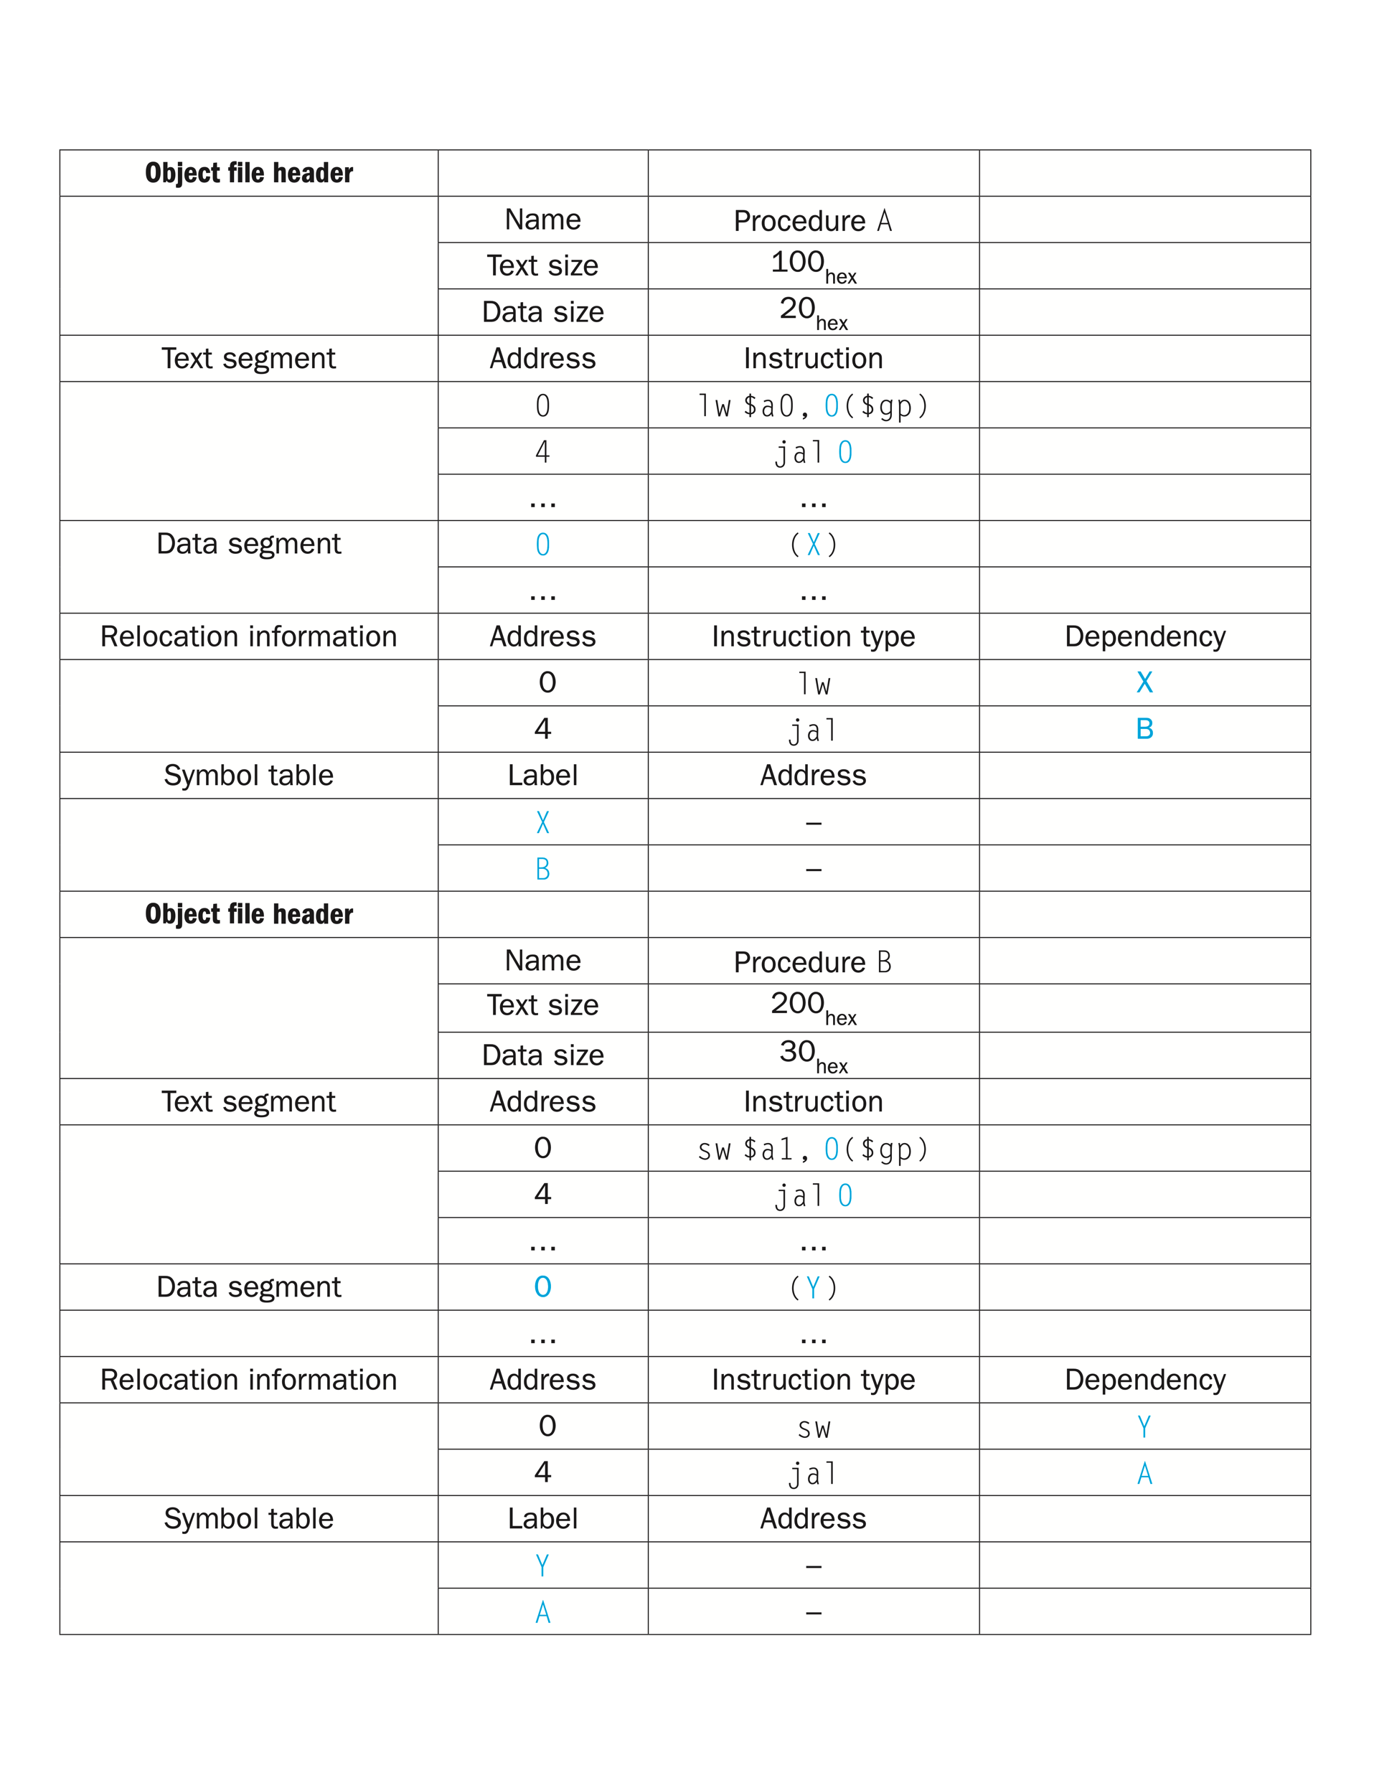
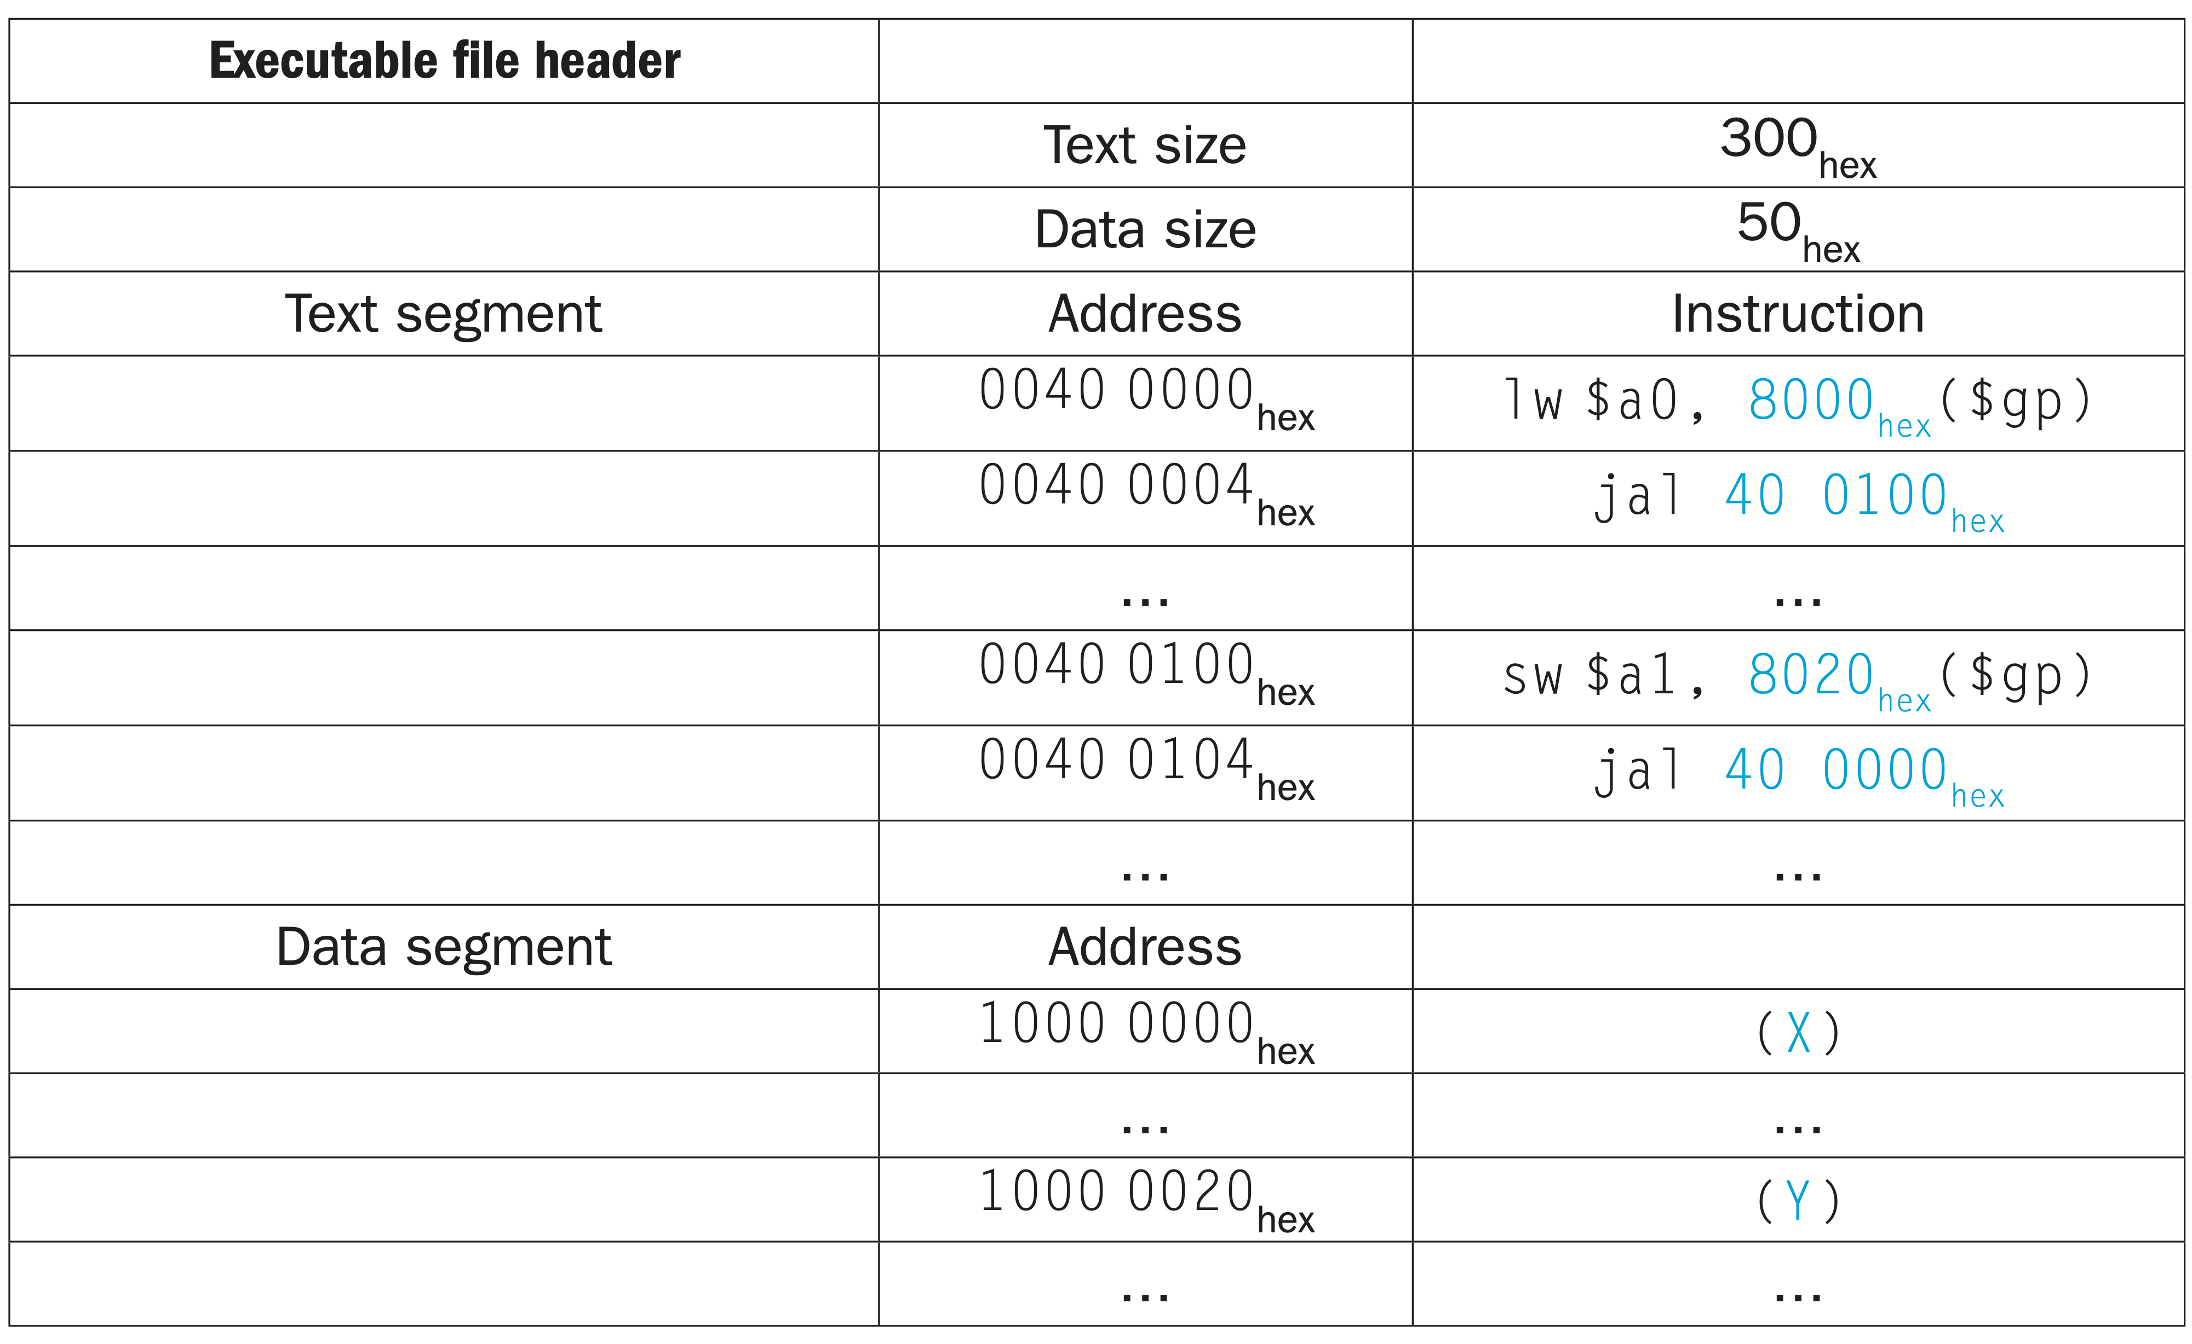
Linking object files
Chapter 2 — Instructions: Language of the Computer — <number>
Notes:
- Note that in the object files we have highlighted the addresses and symbols that must be updated in the link process:
- the instructions that refer to the addresses of procedures A and B and the instructions that refer to the addresses of data words X and Y.
Procedure A needs to find the address for the variable labeled X to put in the load instruction and to find the address of procedure B to place in the jal instruction.
Procedure B needs the address of the variable labeled Y for the store instruction and the address of procedure A for its jal instruction.
- we know that the text segment starts at address 40 0000_hex and the data segment at 1000 0000_hex. The text of procedure A is placed at the first address and its data at the second. The object file header for procedure A says that its text is 100_hex bytes and its data is 20_hex bytes, so the starting address for procedure B text is 40 0100_hex, and its data starts at 1000 0020_hex.
The University of Adelaide, School of Computer Science
Chapter 2 — Instructions: Language of the Computer

Slide 63
Loading a Program
Load from image file on disk into memory
  1. Read header to determine segment sizes
  2. Create virtual address space
  3. Copy text and initialized data into memory
    Or set page table entries so they can be faulted in
  4. Set up arguments on stack
  5. Initialize registers (including $sp, $fp, $gp)
  6. Jump to startup routine
    Copies arguments to $a0, … and calls main
    When main returns, do exit syscall
Chapter 2 — Instructions: Language of the Computer — <number>
Notes:
The University of Adelaide, School of Computer Science
Chapter 2 — Instructions: Language of the Computer
Now that the executable file is on disk, the operating system reads it to memory and starts it. The loader follows these steps in UNIX systems:
Reads the executable file header to determine size of the text and data segments.
Creates an address space large enough for the text and data.
Copies the instructions and data from the executable file into memory.
Copies the parameters (if any) to the main program onto the stack.
Initializes the machine registers and sets the stack pointer to the first free location.
Jumps to a start-up routine that copies the parameters into the argument registers and calls the main routine of the program. When the main routine returns, the start-up routine terminates the program with an exit system call.

Slide 64
Dynamic Linking
Only link/load library procedure when it is called
  Requires procedure code to be relocatable
  Avoids image bloat caused by static linking of all (transitively) referenced libraries
  Automatically picks up new library versions
Chapter 2 — Instructions: Language of the Computer — <number>
Notes:
The University of Adelaide, School of Computer Science
Chapter 2 — Instructions: Language of the Computer
- The library routines become part of the executable code. If a new version of the library is released that fixes bugs or supports new hardware devices, the statically linked program keeps using the old version.
- It loads all routines in the library that are called anywhere in the executable, even if those calls are not executed. The library can be large relative to the program; for example, the standard C library is 2.5 MB.
-These disadvantages lead to dynamically linked libraries (DLLs), where the library routines are not linked and loaded until the program is run. Both the program and library routines keep extra information on the location of nonlocal procedures and their names.

Slide 65

Lazy Linkage
Indirection table
Stub: Loads routine ID,
Jump to linker/loader
Linker/loader code
Dynamically
mapped code
Chapter 2 — Instructions: Language of the Computer — <number>
Notes:
The University of Adelaide, School of Computer Science
Chapter 2 — Instructions: Language of the Computer
lazy procedure linkage version of DLLs, where each routine is linked only after it is called.
The first time the library routine is called, the program calls the dummy entry and follows the indirect jump. It points to code that puts a number in a register to
identify the desired library routine and then jumps to the dynamic linker/loader. The linker/loader finds the desired routine, remaps it, and changes the address in the indirect jump location to point to that routine. It then jumps to it. When the routine completes, it returns to the original calling site. Thereafter, the call to the library routine jumps indirectly to the routine without the extra hops.
In summary, DLLs require extra space for the information needed for dynamic linking, but do not require that whole libraries be copied or linked. They pay a good deal of overhead the first time a routine is called, but only a single indirect jump thereafter.

Slide 66

Starting Java Applications
Simple portable instruction set for the JVM
Compiles bytecodes of “hot” methods into native code for host machine
Interprets bytecodes
Chapter 2 — Instructions: Language of the Computer — <number>
Notes:
The University of Adelaide, School of Computer Science
Chapter 2 — Instructions: Language of the Computer
A Java program is first compiled into a binary version of Java bytecodes, with all addresses defined by the compiler. The Java program is now ready to run on the interpreter, called the Java Virtual Machine (JVM). The JVM links to desired methods in the Java library while the program is running. To achieve greater performance, the JVM can invoke the JIT compiler, which selectively compiles methods into the native machine language of the machine on which it is running.
With JVM, both JVM interpreter and JIT compiler produce native code (aka Machine language code for the underlying physical CPU like x86) from byte code.
- Interpreter (JVM): Reads your source code or some intermediate representation (bytecode) of it and executes it directly. For each hardware architecture different Java bytecode interpreter is needed. When a computer has a Java bytecode interpreter, it can run any Java bytecode program, and the same program can be run on any computer that has such an interpreter.
- JIT compiler: Reads your source code, or more typically some intermediate representation (bytecode) of it, compiles that on the fly and executes machine code. A Jit Compiler translates byte code into machine code and then execute the machine code.
What's the difference between JVM and JIT Compiler:
The difference is in how they generate the native/machine code, how optimized it is as well how costly the optimization is. Informally, an interpreter pretty much converts each byte-code instruction to corresponding native/machine instruction by looking up a predefined JVM-instruction to machine instruction mappingz. Interestingly, a further speedup in execution can be achieved, if we take a section of byte-code and convert it into machine code - because considering a whole logical section often provides rooms for optimization as opposed to converting (interpreting) each line in isolation (to machine instruction). This very act of converting a section of byte-code into (presumably optimized) machine instruction is called compiling (in the current context). When the compilation is done at run-time, the compiler is called JIT compiler.
The co-relation and co-ordination:
Since Java designer went for (hardware & OS) portability, they had chosen interpreter architecture (as opposed to c style compiling, assembling, and linking). However, in order to achieve more speed up, a compiler is also optionally added to a JVM. Nonetheless, as a program goes on being interpreted (and executed in physical CPU) "hotspot"s are detected by JVM and statistics are generated. Consequently, using statistics from interpreter, those sections become candidate for compilation (optimized native code). It is in fact done on-the-fly (thus JIT compiler) and the compiled machine instructions are used subsequently (rather than being interpreted). In a natural way, JVM also caches such compiled pieces of code.

Slide 67
C Sort Example
Illustrates use of assembly instructions for a C bubble sort function
Swap procedure (leaf)
  void swap(int v[], int k)
  {
  int temp;
  temp = v[k];
  v[k] = v[k+1];
  v[k+1] = temp;
  }
  v in $a0, k in $a1, temp in $t0
§2.13 A C Sort Example to Put It All Together
Chapter 2 — Instructions: Language of the Computer — <number>
Notes:
The University of Adelaide, School of Computer Science
Chapter 2 — Instructions: Language of the Computer
- A C procedure that swaps two locations in memory.
- When translating from C to assembly language by hand, we follow these general steps:
1. Allocate registers to program variables.
2. Produce code for the body of the procedure.
3. Preserve registers across the procedure invocation.

Slide 68
The Procedure Swap
swap: sll $t1, $a1, 2 # $t1 = k * 4
add $t1, $a0, $t1 # $t1 = v+(k*4)
# (address of v[k])
lw $t0, 0($t1) # $t0 (temp) = v[k]
lw $t2, 4($t1) # $t2 = v[k+1]
sw $t2, 0($t1) # v[k] = $t2 (v[k+1])
sw $t0, 4($t1) # v[k+1] = $t0 (temp)
jr $ra # return to calling routine
Chapter 2 — Instructions: Language of the Computer — <number>
Notes:
The University of Adelaide, School of Computer Science
Chapter 2 — Instructions: Language of the Computer
MIPS assembly code of the procedure swap
-The MIPS convention on parameter passing is to use registers $a0, $a1, $a2, and $a3.
-Since swap has just two parameters, v and k, they will be found in registers $a0 and $a1.
- The only other variable is temp, which we associate with register $t0 since swap is a leaf procedure
-Recall that the memory address for MIPS refers to the byte address, and so words are really 4 bytes apart. Hence we need to multiply the index k by 4 before adding it to the address.
-Forgetting that sequential word addresses differ by 4 instead of by 1 is a common mistake in assembly language programming. Hence the first step is to get the address of v[k] by multiplying k by 4 via a shift left by 2

Slide 69
The Sort Procedure in C
Non-leaf (calls swap)
  void sort (int v[], int n)
  {
  int i, j;
  for (i = 0; i < n; i += 1) {
  for (j = i – 1;
  j >= 0 && v[j] > v[j + 1];
  j -= 1) {
  swap(v,j);
  }
  }
  }
  v in $a0, k in $a1, i in $s0, j in $s1
Chapter 2 — Instructions: Language of the Computer — <number>
Notes:
The University of Adelaide, School of Computer Science
Chapter 2 — Instructions: Language of the Computer
A C procedure that performs a sort on the array v

Slide 70
The Procedure Body
move $s2, $a0 # save $a0 into $s2
move $s3, $a1 # save $a1 into $s3
move $s0, $zero # i = 0
for1tst: slt $t0, $s0, $s3 # $t0 = 0 if $s0 ≥ $s3 (i ≥ n)
beq $t0, $zero, exit1 # go to exit1 if $s0 ≥ $s3 (i ≥ n)
addi $s1, $s0, –1 # j = i – 1
for2tst: slti $t0, $s1, 0 # $t0 = 1 if $s1 < 0 (j < 0)
bne $t0, $zero, exit2 # go to exit2 if $s1 < 0 (j < 0)
sll $t1, $s1, 2 # $t1 = j * 4
add $t2, $s2, $t1 # $t2 = v + (j * 4)
lw $t3, 0($t2) # $t3 = v[j]
lw $t4, 4($t2) # $t4 = v[j + 1]
slt $t0, $t4, $t3 # $t0 = 0 if $t4 ≥ $t3
beq $t0, $zero, exit2 # go to exit2 if $t4 ≥ $t3
move $a0, $s2 # 1st param of swap is v (old $a0)
move $a1, $s1 # 2nd param of swap is j
jal swap # call swap procedure
addi $s1, $s1, –1 # j –= 1
j for2tst # jump to test of inner loop
exit2: addi $s0, $s0, 1 # i += 1
j for1tst # jump to test of outer loop
Move
params
Outer loop
Inner loop
Pass
params
& call
Inner loop
Outer loop
Chapter 2 — Instructions: Language of the Computer — <number>
Notes:
The University of Adelaide, School of Computer Science
Chapter 2 — Instructions: Language of the Computer
- Find the description on page 136-137 in the textbook.

Slide 71
The Full Procedure
sort: addi $sp,$sp, –20 # make room on stack for 5 registers
sw $ra, 16($sp) # save $ra on stack
sw $s3,12($sp) # save $s3 on stack
sw $s2, 8($sp) # save $s2 on stack
sw $s1, 4($sp) # save $s1 on stack
sw $s0, 0($sp) # save $s0 on stack
… # procedure body
…
exit1: lw $s0, 0($sp) # restore $s0 from stack
lw $s1, 4($sp) # restore $s1 from stack
lw $s2, 8($sp) # restore $s2 from stack
lw $s3,12($sp) # restore $s3 from stack
lw $ra,16($sp) # restore $ra from stack
addi $sp,$sp, 20 # restore stack pointer
jr $ra # return to calling routine
Chapter 2 — Instructions: Language of the Computer — <number>
Notes:
The University of Adelaide, School of Computer Science
Chapter 2 — Instructions: Language of the Computer

Slide 72




Effect of Compiler Optimization
Compiled with gcc for Pentium 4 under Linux
Chapter 2 — Instructions: Language of the Computer — <number>
Notes:
The University of Adelaide, School of Computer Science
Chapter 2 — Instructions: Language of the Computer
shows the impact of compiler optimization on sort program performance,, instruction count, clock cycles, and CPI.
Refer to page 37 (textbook) to know more about relation between IC, Clock cycle, performance and CPI
Note that unoptimized code (none) has the best CPI, and O1 optimization has the lowest instruction count, but O3 is the fastest, reminding us that time is the only accurate measure of program performance.

Slide 73



Effect of Language and Algorithm
Chapter 2 — Instructions: Language of the Computer — <number>
Notes:
The University of Adelaide, School of Computer Science
Chapter 2 — Instructions: Language of the Computer
- compares the impact of programming languages, compilation versus interpretation, and algorithms on performance of sorts.
Bubble sort/ Quick sort - Java/Interpreter has the worst performance, (less than unoptimized c code). unoptimized C program is 8.3 times faster than the interpreted Java code for Bubble Sort. Using the JIT compiler makes Java 2.1 times faster than the unoptimized C and within a factor of 1.13 of the highest optimized C code.
The bottom graph shows the impact of a better algorithm, offering three orders of magnitude a performance increases by when sorting 100,000 items.

